Slide 1
WSN Middleware
2007.4
MMWang

Slide 2
Motivation
The gap between the high-level requirements from pervasive computing applications, and the underlying operation of WSNs
  such as high flexibility, re-usability, and reliability,
  restricted resource, dynamic topology, and low level embedded APIs, etc.

Slide 3
Why it deserves research
Providing reusable code services (such as code update) and data services (such as data filter),
Helps in infrastructure (sensor nodes and networks) management and adaptation
Helps in system integration, monitoring, as well as system security.

Slide 4
New challenges
-- Traditional distributed middleware
-- Mobile and embedded computing middleware,
-- unique addresses of nodes, Data aggregation
-- Traditional middleware is not light weight
-- Specific hardware

Slide 5
Reference Model of WSN Middleware overview
WSN –middleware Aspects
Programming abstraction
Middleware Services
Runtime-
Support
QOS concerns

Slide 6
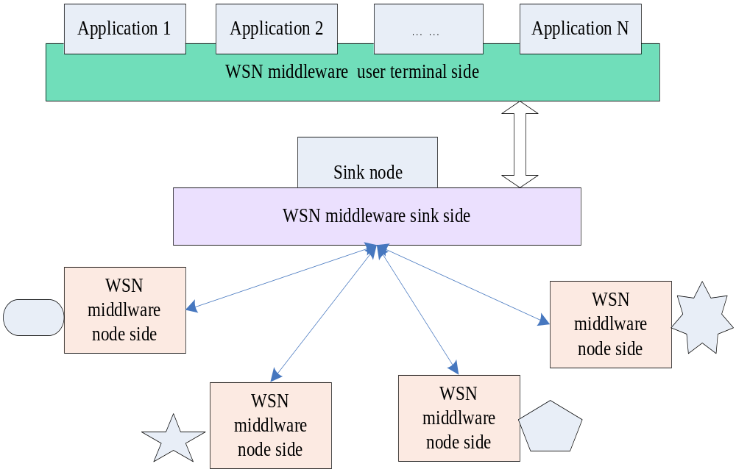
WSN middleware system model

Slide 7
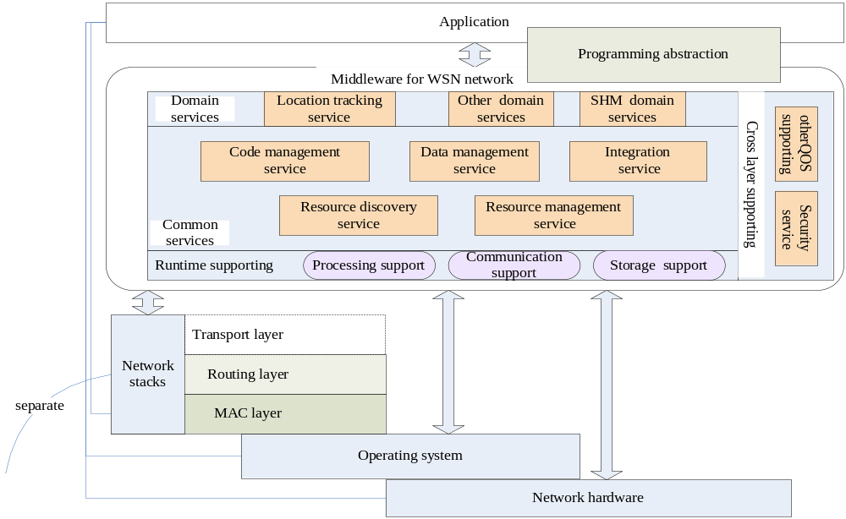
Framework

Slide 8
Code management Implementation
Task allocation
  ask allocation specifies a set of sensor nodes, on which the execution will be activated
  How
    Script matching
    query optimizer
    configuration adaptation
Task migration
  The task migration means the methods to transfer a task from a sensor node to another
  mobile codes , mobile Java object
Task coordination
  Useful when multi tasks are reside in the WSNs
  Tuple space approach

Slide 9
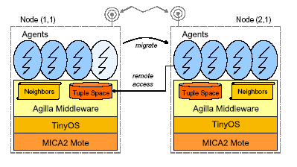
Code management Implementation
Example

Slide 10
Code management Implementation
What ?
  Data acquisition
    TinyDB, DSware ,Mires ,impala
    TinyDB[30] ,Cougar[34], and SensorWare[45]
  Data processing
  Data storage
Different data model different management
  Event based
  Inquiry based
  Continues

Slide 11
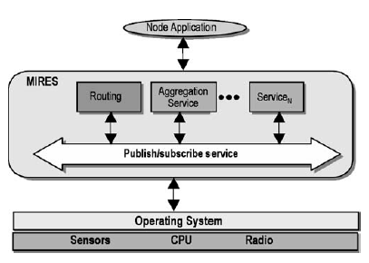
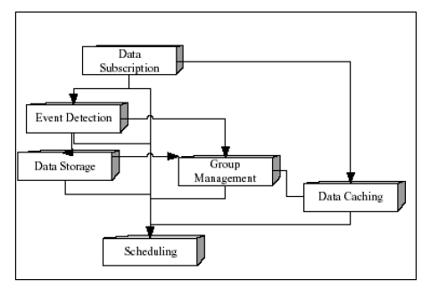
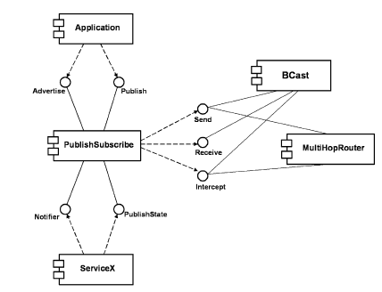
Data management Implementation
SELECT AVG (temp)
FROM sensors (select rows from Sensors)
WHERE floor = 3 (at the 3rd floor)
GROUP BY room (rows are grouped by room number)
AVG (temp) > 80F (only groups with average temperature > 80F)
SAMPLE PERIOD 20 seconds (perform every 20 seconds—rate of collection)

Slide 12
Resource discovery Implementation
Resource
  hardware resource (e.g. energy, memory, A/D device, communication module)
  network resource (e.g. topology, routing, system time, location)
Aim
  Context aware
  self-organization
How
  (SLP [40], Bluetooth SDP [41] [42]
  tuple space

Slide 13
Resource management Implementation
Cluster service
  EnviroTrack, MiLAN, DSWare, AutoSec, SINA
  Generic
Schedule service
  Level
  MAC layer and CPU voltage scaling in physical layer.
Network protocol management (routing management) service
  None
  One: MagnetOS
  Overlay : Mires
  Adaptation:MiLan
  Switch : Impala

Slide 14
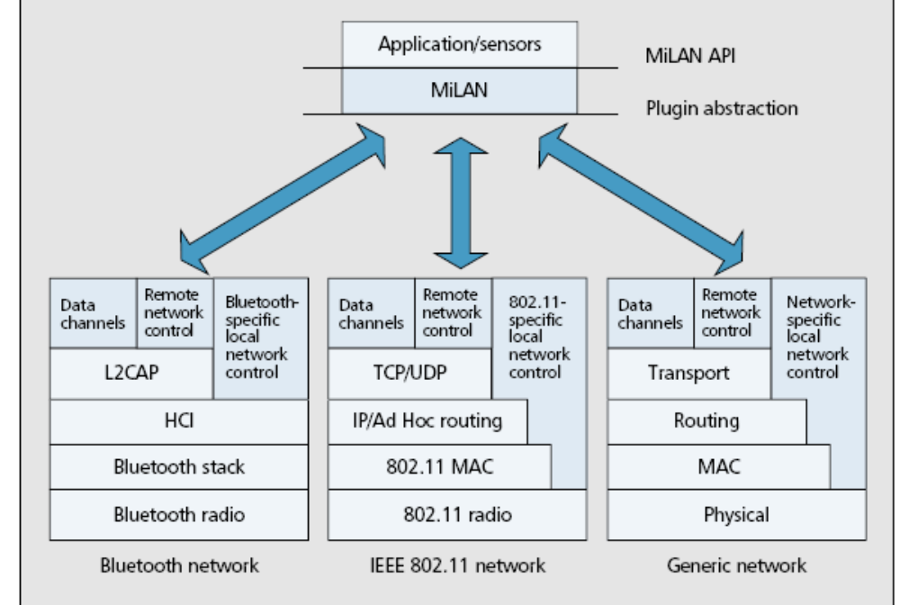
Resource management Implementation
MiLAN

Slide 15
Integration Implementation
Why
  internet [7] or gird networks [61-64] or database [65]
How
  Proxy server
  Service oriented approach
    WSDL language and SOAP
  Sensor web
    The Sensor Web Enablement (SWE) standard
    SensorML,
    Observation & Measurement,
    Sensor Collection Service,
    Sensor Planning Service
    Web Notification Service.

Slide 16
WSN-middleware runtime supports Implementation
Why
  multi-thread processing,
  smart task scheduling,
  synchronization of memory accessing and the spread signal spectrum management.
What
  is always operation system dependent.
  Basic functions of runtime supports include inter-process communication (IPC) between tasks, memory control,
  and possible power control in terms of voltage scaling and component activation and inactivation

Slide 17
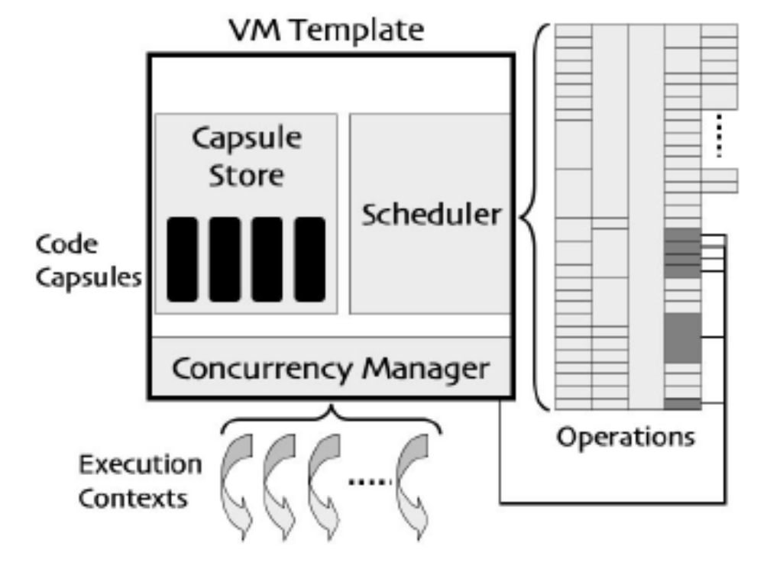
WSN-middleware runtime supports Implementation
Mate [28]
Magnet [17]

Slide 18
WSN-middleware QoS Implementation
nonfunctional requirements, such as Fault-tolerance, Security, or reliability.
parameters for expressing QoS of WSN include packet delay, jitter, loss, bandwidth, throughput, precision, and latency,
parameters for expressing QoS of WSN applications include accuracy, aggregation delay, aggregation degree, coverage, precision
collective QoS

Slide 19
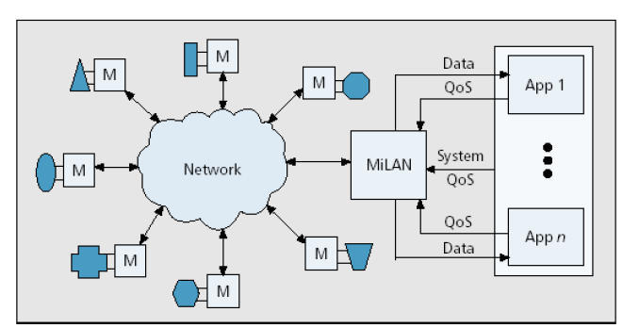
WSN-middleware QoS Implementation
MiLAN

Slide 20
Existing works
Feature tree
Analysis

Slide 21
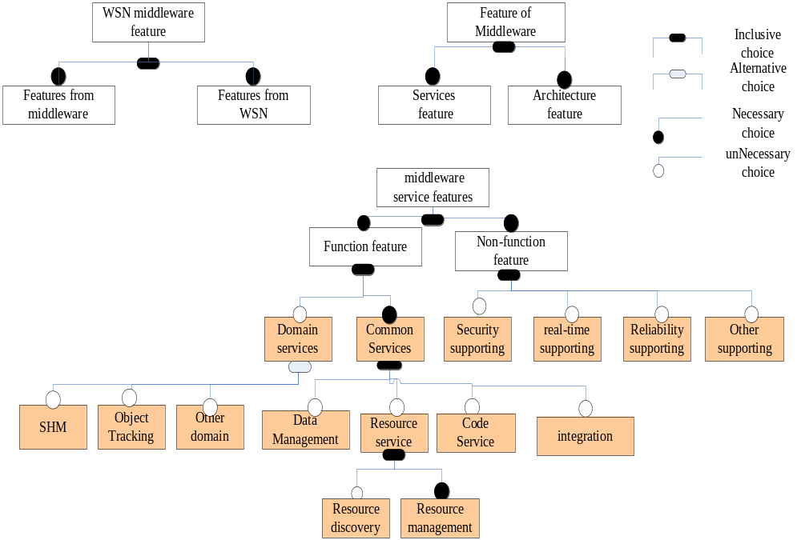

Slide 22
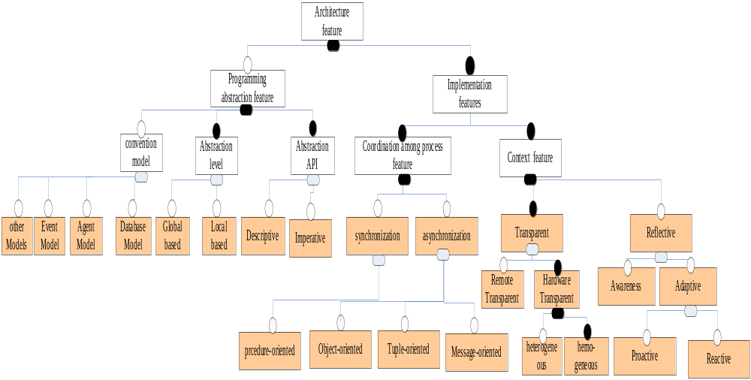

Slide 23
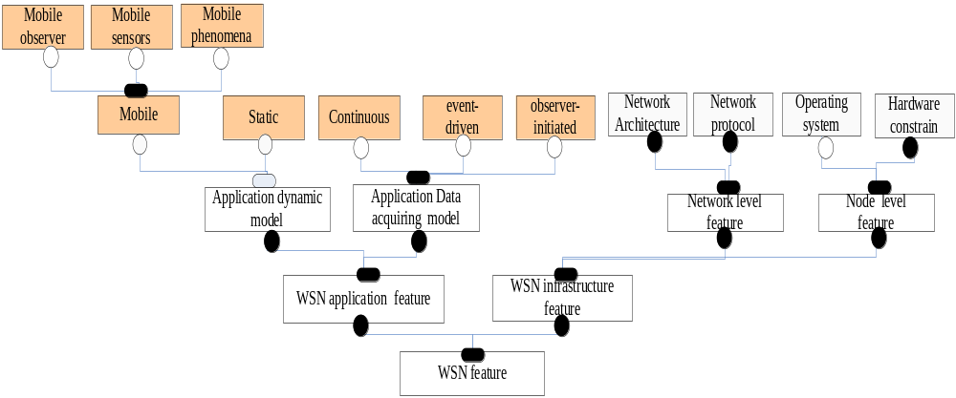

Slide 24
Features Proposal | Programming abstraction features |  |  | Middleware service features
 | Level | API | convention | Functional | NoneFuntional
Sensor Ware | Declarative | Local | Database | CodeManagement | None
MagnetOS | Imperative (java language) | Global | virtual machine | CodeManagement ResourceManagement | None
Mate | Imperative (motle,byte code) | Local | virtual machine | CodeManagement ResourceManagement | Security
MiLAN | None | None | None | ResourceManagement Resource discovery | None
SINA | Declarative(cells data format SQTL) | Global | Database | DataManagement | None
TinyDB | Declarative (ACQP language) | Global | Database Graphic UI | DataManagement Resourcemanagement | None
Cougar | Declarative (XML data format , SQL-like language ) | Global | Graphic UI | DataManagement | None
Impala | None | None | Mobile agent | Code Management ResourceManagement Storage supporting | Security
Agilla | Imperative (compile-like ) | Local | Mobile agent | Code Management | None
FACTS | Declarative (Facts, rules, functions, XML like ) | Global | Rule based | CodeManagemet DataManagemet | None
AutoSec | None | None | None | Service discovery Resourcemanagement | None
DSWare | Declarative | Global | None | Data management ResourceManagement Storage supporting | Real-time Reliability
A service approach | Declarative (XML,SOAP) | Global | None | Data management Integration Resource discovery | None
Mire | Imperative | Local | Graphic UI | Data management | None
Enviro Track | Imperative object-based (context object and tracking objects ) | Global | None | Data management Resource discovery Resourcemanagement | None

Slide 25
Features proposal | Internal Implementation Features |  |  | Supporting Application features |  | based WSN structure features
 | Process Communication | Context |  | Application Dynamic | Inquire Data model | Network Level | Node Level
 |  | Transparent | Reflective
Sensor Ware | Asynchronous Tuple oriented | Homo | None | Mobile phenomena | All | None | Linux IPAQ
MagnetOS | Asynchronous | Homo/ hetero | None | All | All | Ad-hoc on-demand routing | based Build on PC
Mate | Synchronous Asynchronous | Homo | None | All | All | Content-based routing | TinyOS based;
MiLAN | Synchronous Asynchronous | hetero | Proactive | All | Event driven | Switch between different protocols | None
SINA | ASynchronous | Remote Homo | None | Static | Enquire | Cluster-based | None
TinyDB | Asynchronous | Homo | None | Static/mobile sensor | Enquire/ Event driven | Spanning tree based Routing | TinyOS mote
Cougar | Asynchronous | Remote Homo | None | Static | Enquire | Directed diffusion routing Cluster-based | None
Impala[18] (designed for ZebraNet) | Asynchronous | homo | Adaptive | Mobile sensors | Event driven | Switch between different protocols | iPAQ / PC Linux
Agilla | Asynchronous (tuple based ) | homo | None | All | Any | Multi-protocol routing | Tiny OS, MICA2,
FACTS | Asynchronous Tuple oriented | homo | None | All | Event driven | None | None
AutoSec | Asynchronous Broker based | homo | Proactive | All | No | None | Tiny OS
DSWare | Asynchronous Pub-sub based | homo | None | All | Event driven | Cluster-based | None
A service approach | Asynchronous (pub-sub) | homo Remote | Reflective Proactive | All | Event driven | Directed diffusion | None
Mire | Asynchronous (pub-sub) | homo | None | All | Event driven | Cluster-based | TinyOS
Enviro Track | Asynchronous Synchronous | homo | None | Mobile- phenomena | Continues / Event drivent | Group based Content-based Routing | TinyOS.

Slide 26
Proposal | Test environment | Simulation and testing tools | Published Evaluation Results
Sensor Ware[45] | Prototype | SensorSim | Framework size, execution delays, Energy consumption
MagnetOS[46] | JVM | Custom simulator | Internal algorithm Comparison in Simulator
Mate[28][29] | Prototype | TOSSIM | Byte code overhead, installation costs, code infection performance
MiLAN[23] | None | None | None
SINA[33] | Simulation | GloMosim | SINA networking overhead, application performance
TinyDB[30] | Simulation Prototype | Custom environment | Query routing performance in simulation ,sample accuracy and sampling frequency in prototypes
Cougar[34] | None | None | None
Impala[18] | Simulation | ZnetSim | System Implementation and Overhead, Impala event processing time, Software transmission volume.
Agilla[80] | Prototype | Mica 2 | Reliability of remote tuple space and agent migration operations, overhead of Agilla’s instructions. Case Study.
FACTS[36] | None | None | None
AutoSec[57] | Simulation | Custom environment | Information collection overhead, Overall performance efficiency
DSWare[32] | Simulation | GloMoSim | Performance in Reduction of Communication, Impact of Node Density, Performance in Reaction Time
Mire[38] | None | None | Case study
Enviro Track[17] | prototype | Mica 2 | Communication Performance Data, Effect of Sensory Radius on Maximum Trackable Speed
Service oriented Middleware [35] | None | None | WSDL documents for describing The WSN services and the SOAP messages format and content.

Slide 27
Challenges
Challenges coming from the conflict between distributed computing context requirements and the embedded device attributes
Challenges coming from the trade-offs between the degree of application specificity and middleware generality
Challenges coming from the new context of Quality of service

Slide 28
Issues
New kinds of sensor nodes and networks
Pervasive middleware and WSN middleware
Integration approaches and frameworks
Component based architecture
Design patterns
OS + middleware
Shared memory
simulation and evolution metrics

Slide 29
Thank you ☺

